Slide 1
Intelligently Ordering Machine Translation Seed Data to Improve Local Language Translation
Team - SIL Machine Translation
04-09-2022

Slide 2

45Billion USD

Slide 3


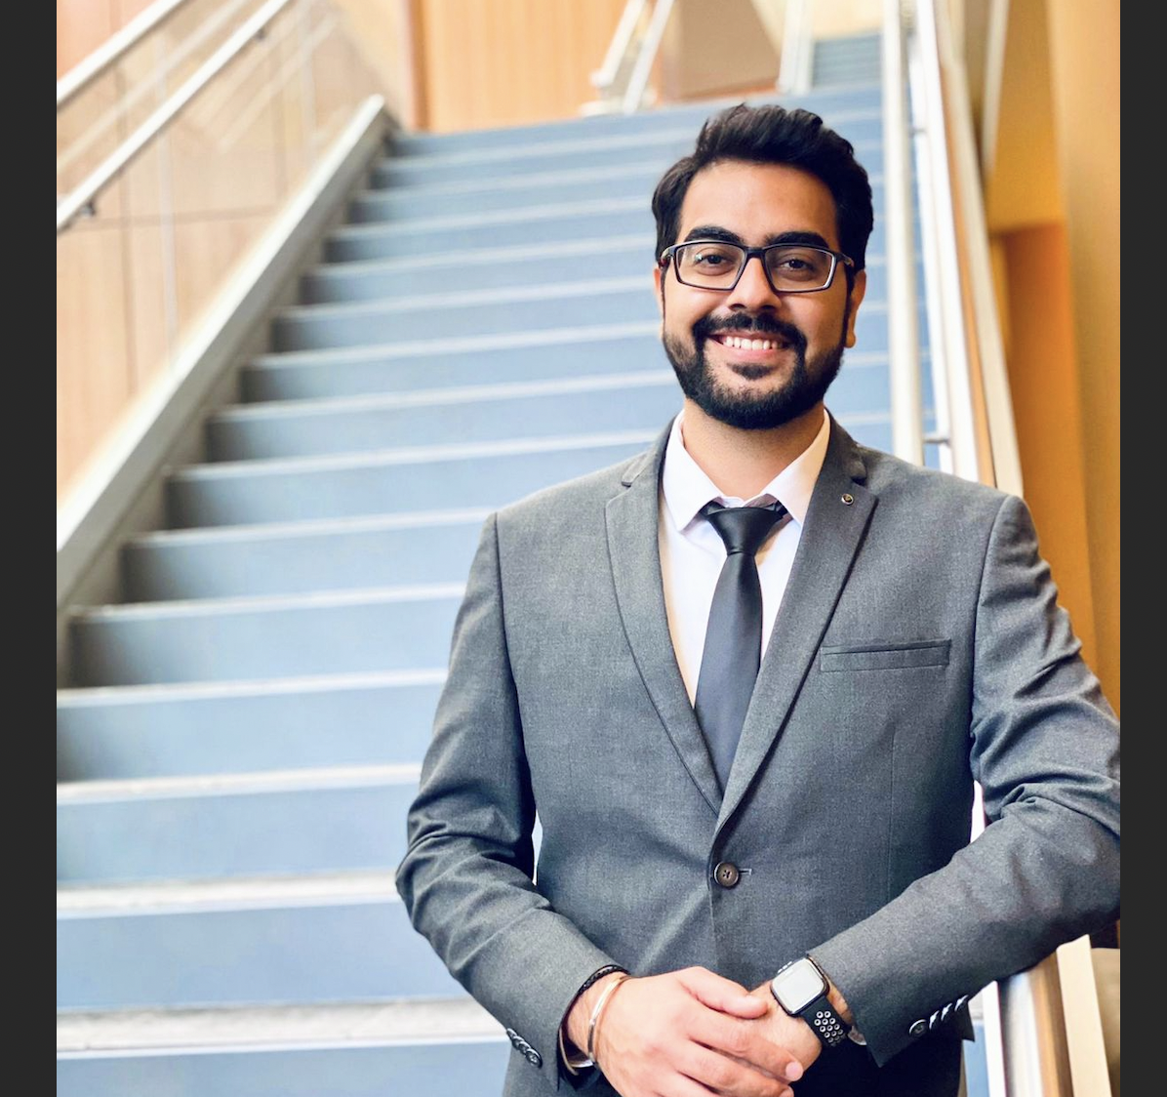
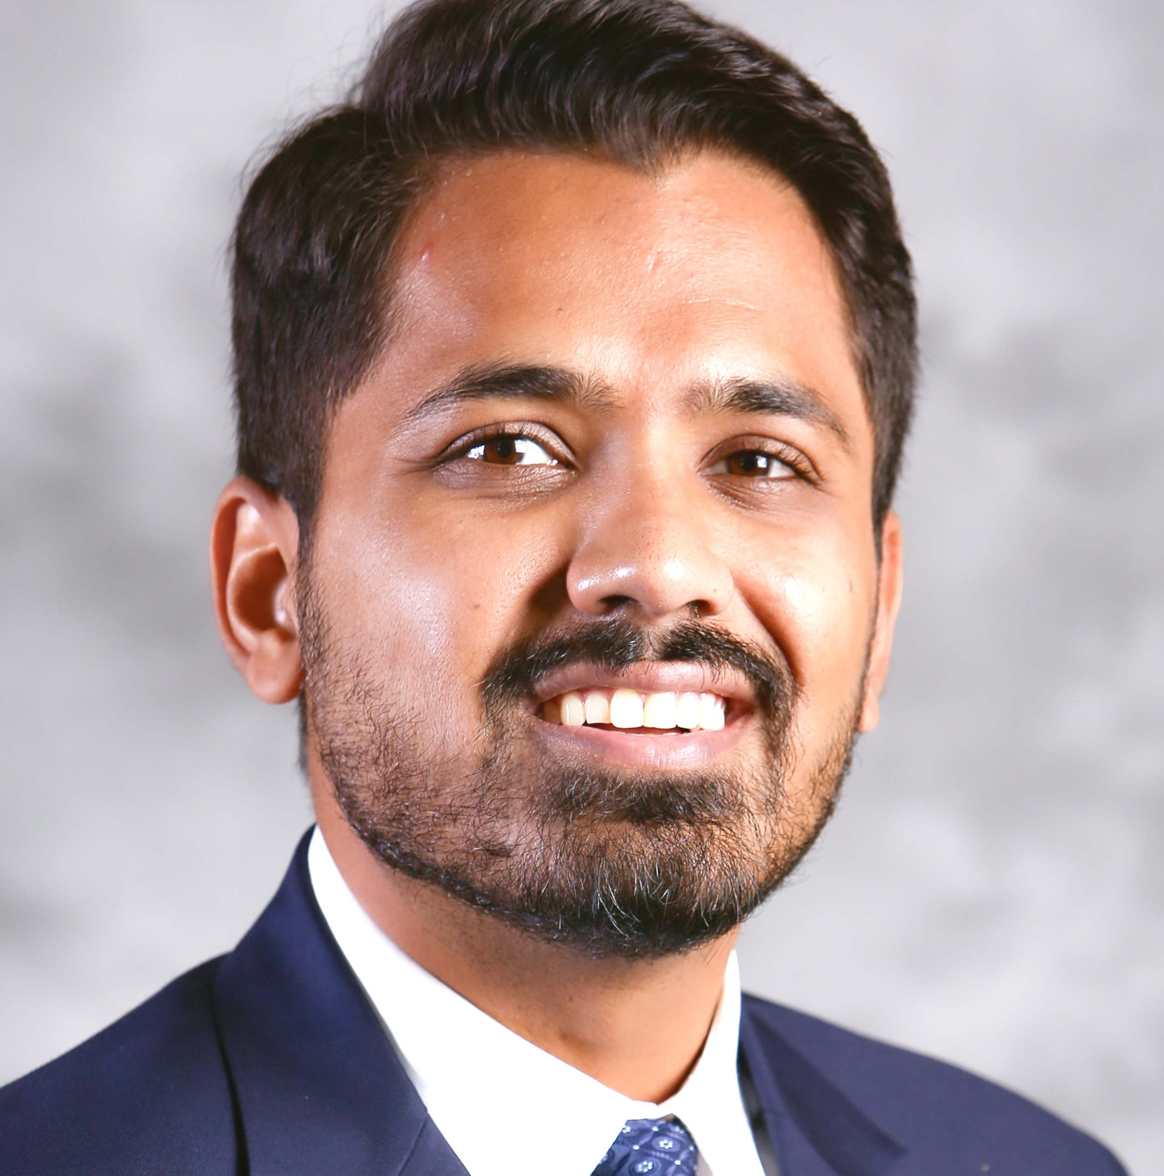
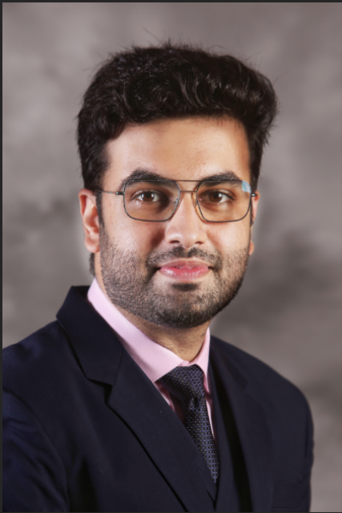

Let's meet the team that made it possible.
Paul Chen
NLP Engineer
Jay Lee
Data Engineer
Manideep Sharma
Analytics Manager
Amaan Ansari
Optimization Engineer
Devansh Batra
Optimization
Engineer
Gagan Pahuja
Data Engineer

Slide 4
Agenda
Problem Statement
Understanding the Methodology
Performing Data Cleaning and EDA
Why did we choose a particular NMT Transformer?
Business Impact and Conclusion

Slide 5
What’s the big issue?
Large input dataset
Even the highly
sophisticated NLP engines
need huge amount of translated
data to provide Accurate Translation

Slide 6
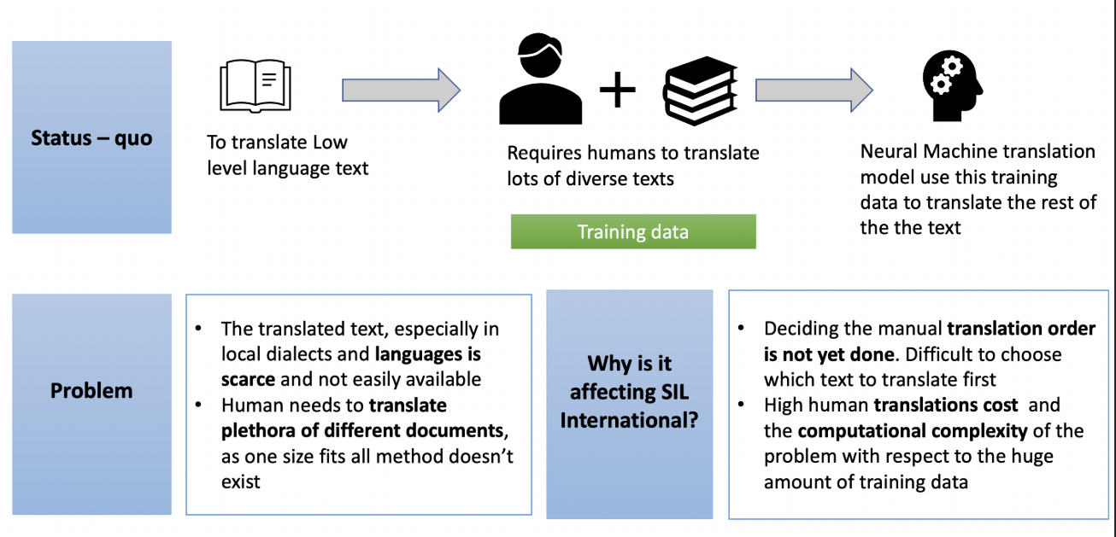
Understanding the business problem

Slide 7
Is there a better way?
YES!
Identify the order
of translation that will
help save cost and time by
involving optimized seed data
for the machine translation models

Slide 8
Literature Review

Slide 9
What pre-existing research did we go over?
Research Paper | Key Takeaways
Laura Martinus and Jade Abbott(2019) | Training techniques for low resource languages
Marlies van der Wees, Arianna Bisazza, Christof Monz(2017) | Dynamic data selection
Ranathunga, S., Lee, E. S. A., Skenduli, M. P., Shekhar, R., Alam, M., & Kaur, R. (2021) | Quantitative methods to access low resource language translation

Slide 10
Methodology

Slide 11
Methodological workflow
Map the semantic domain (main topics) from each Bible chapter
List out all possible chapter orders
Apply Joey NMT
Get BLEU score / accuracy score
Determine best chapter order

Slide 12
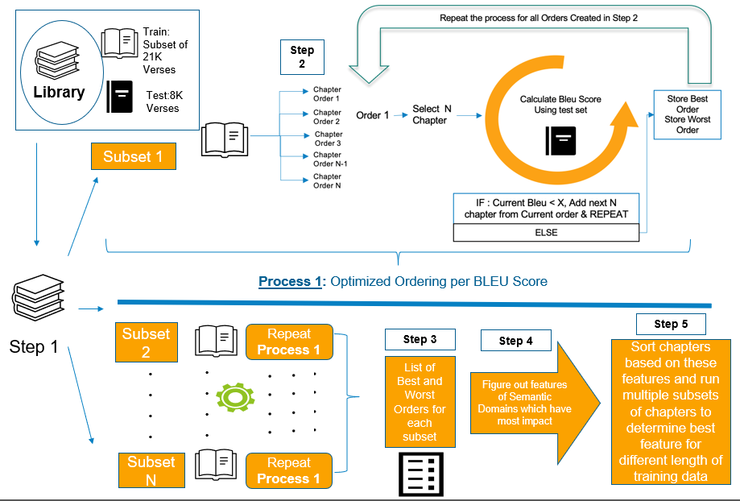
Methodology

Slide 13
Data overview & EDA

Slide 14
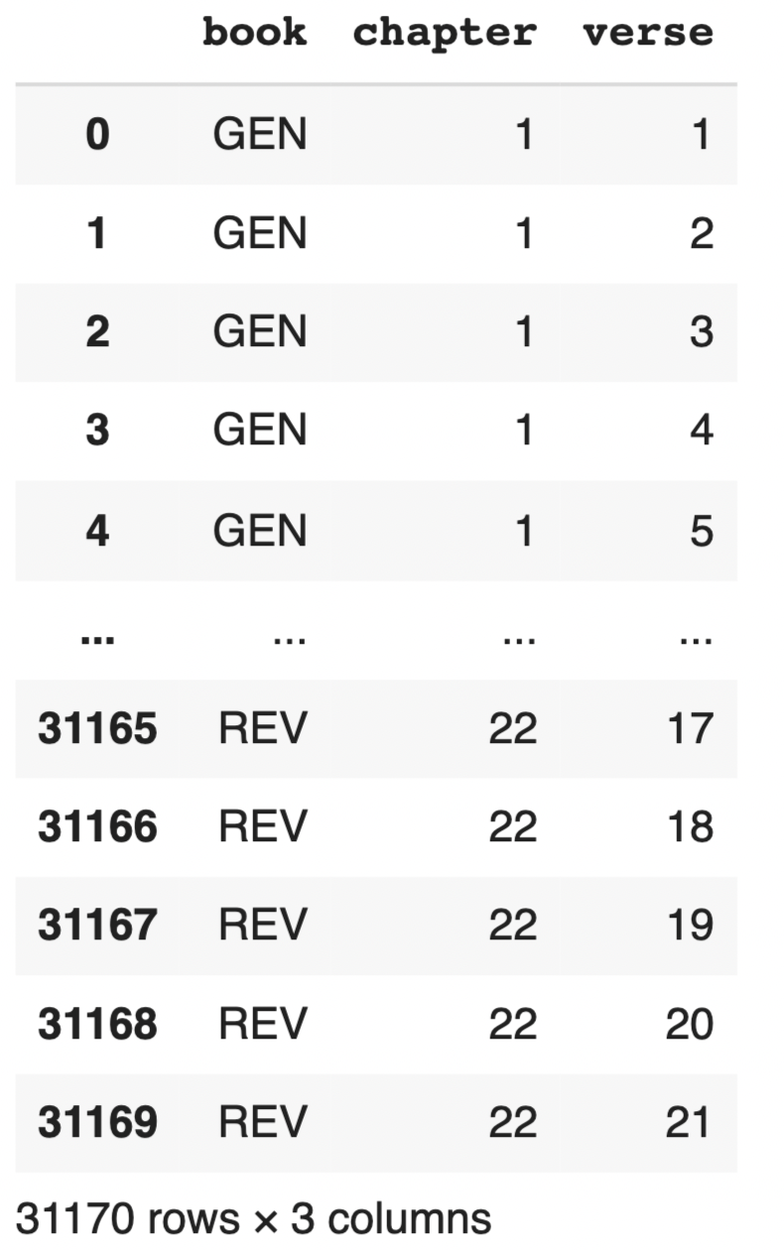
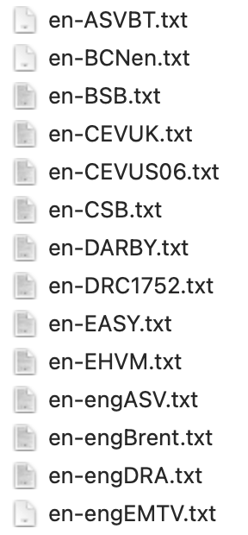
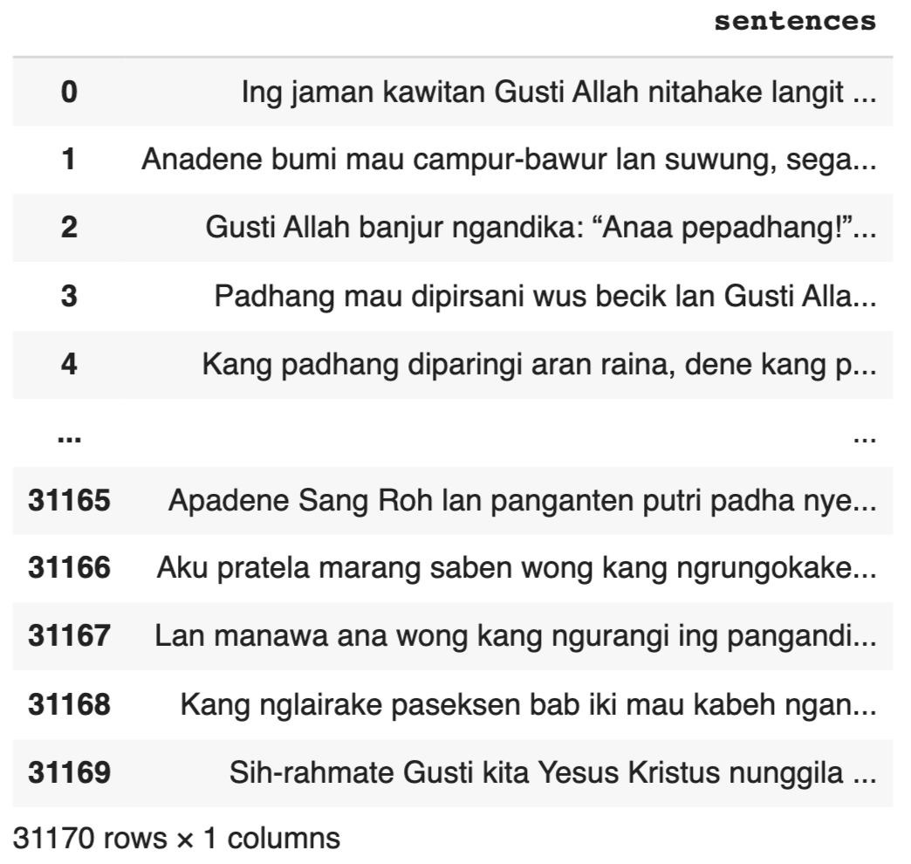
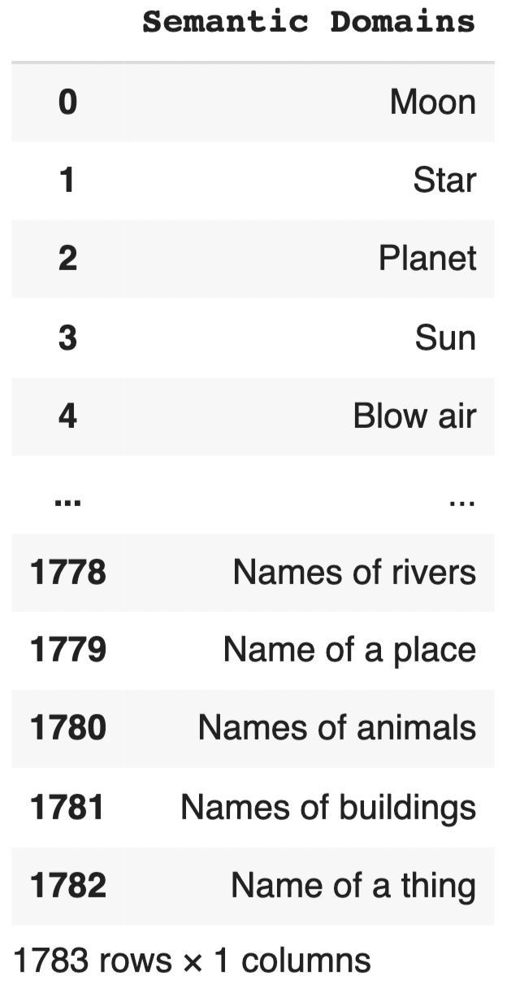
Data & EDA – data overview
1
Verse reference
66 books
1189 chapters
31169 verses
2
69 English bibles
by verse
31169 verses
3
Javanese/Malay corpora by verse
31169 verses
4
1,783 semantic
domain words

Slide 15
Data preprocessing steps
Process 1
Process 2
Process 3
Output 1
Choose 1 English bible out of 69
Alignment
Data cleaning
(removing blanks/ranges)
2 Parallel corpora
(eng-jav | eng-mal)
Output 2
Process 6
Process 5
Process 4
Semantic domain
distribution table
Cosine similarity
Vectorization
(word/sentence embedding)
Normalization
(tokenize, lemmantize, etc.)
Process 7
Output 3
Model Building
Quantify chapters
Parallel corpora w/
diversity, depth

Slide 16
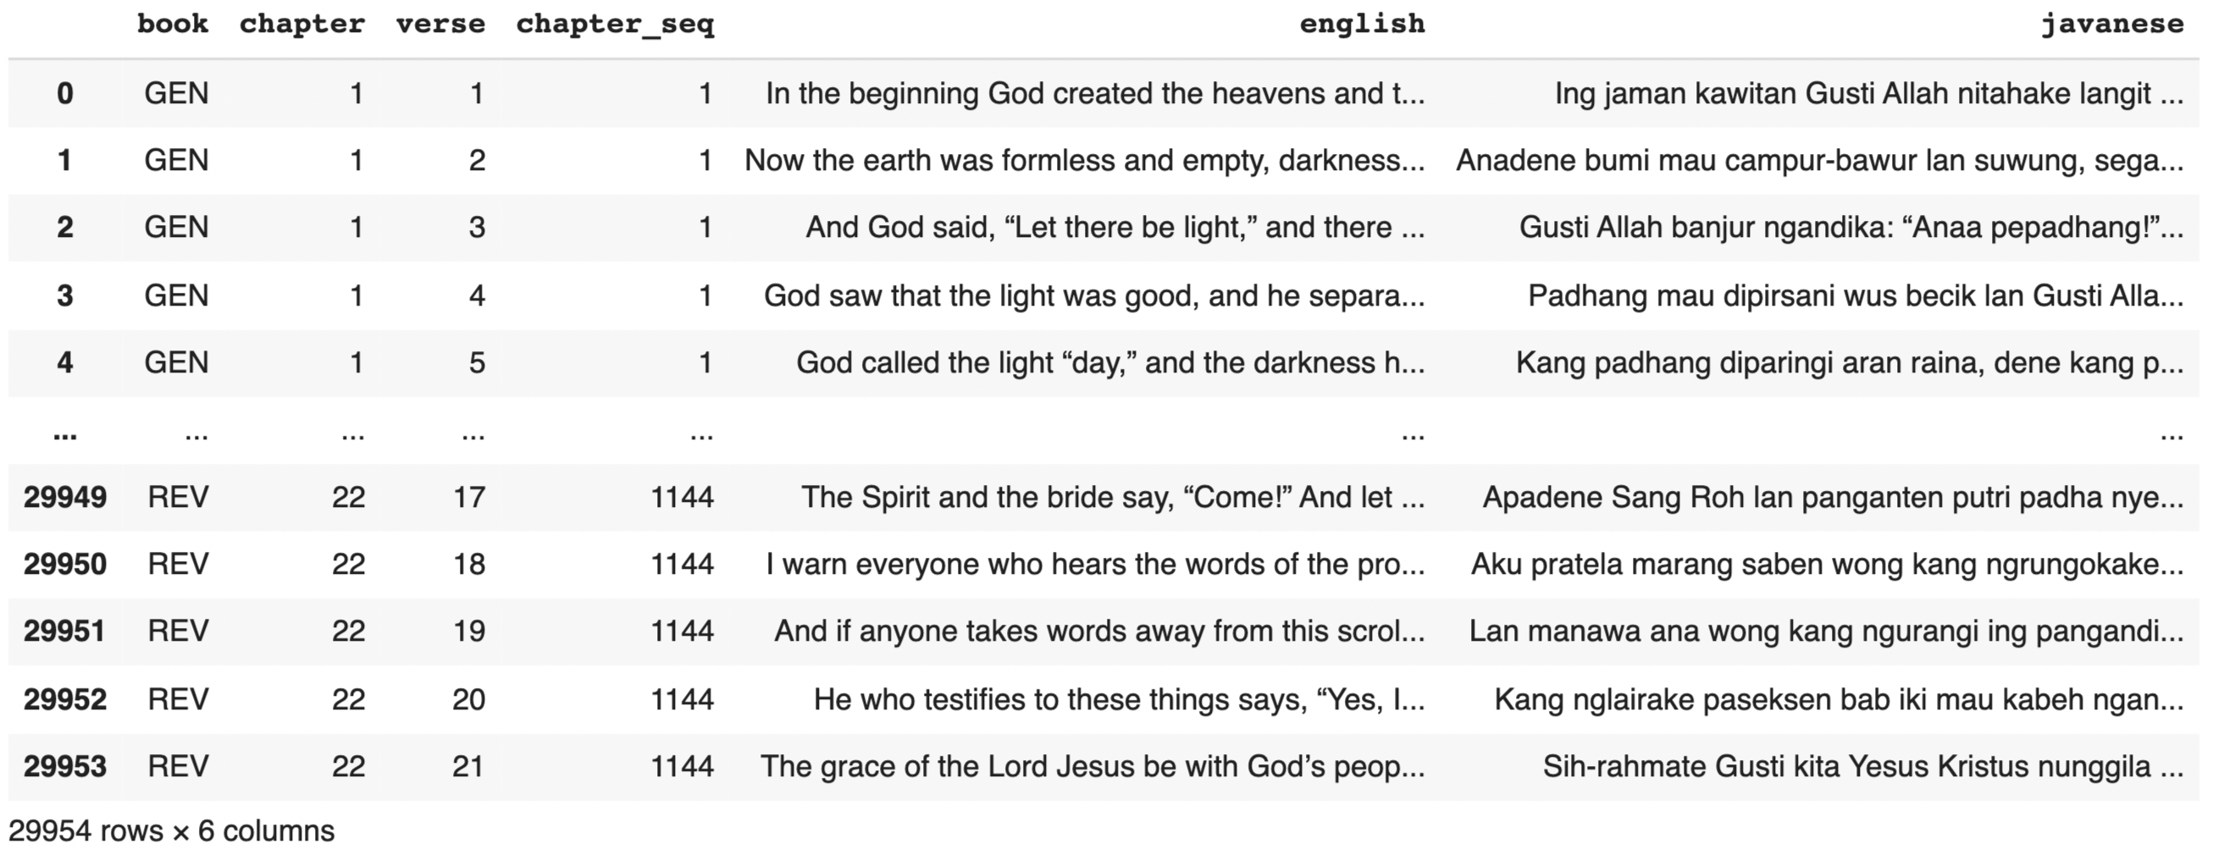
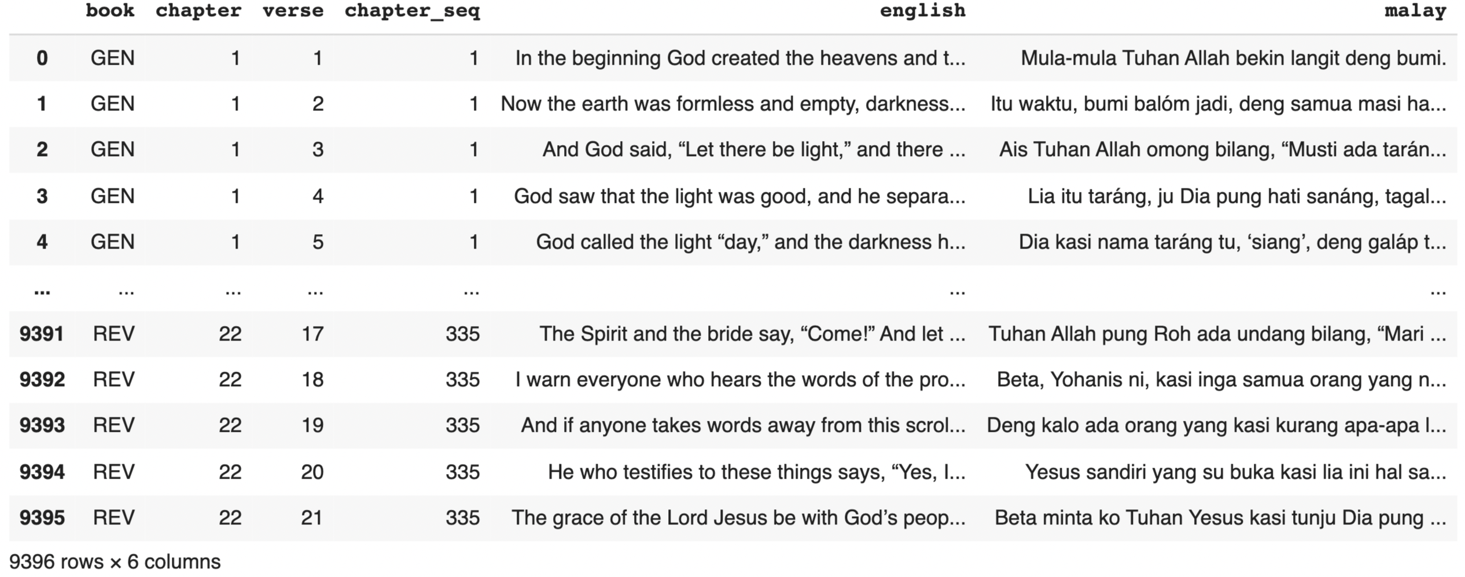
Data & EDA – 2 parallel corpora data frames
Javanese
1144 chapters
29953 verses
Malay
335 chapters
9395 verses

Slide 17
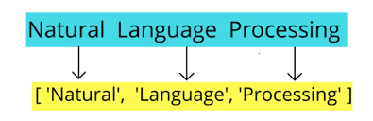
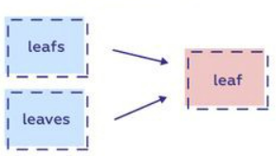
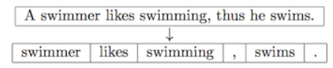
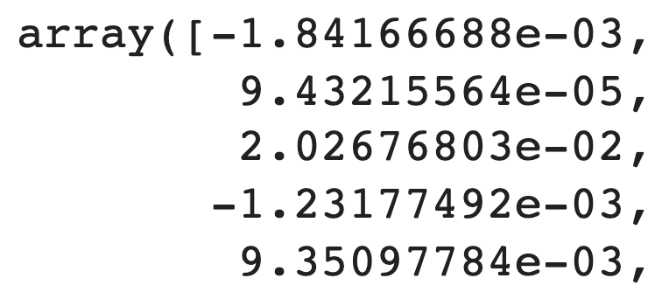
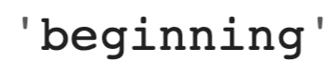
Data & EDA – Normalization and vectorization
Converted text into numerical array forms
Normalization
Tokenization
Stopwords removal
Lemmatization
Vectorization
Converted each word from bible and semantic domain into numerical array to make computation faster
d
Each word formed into [300, 1] array to get similarity scores between words in Bible and semantic domain
…
300 elements

Slide 18
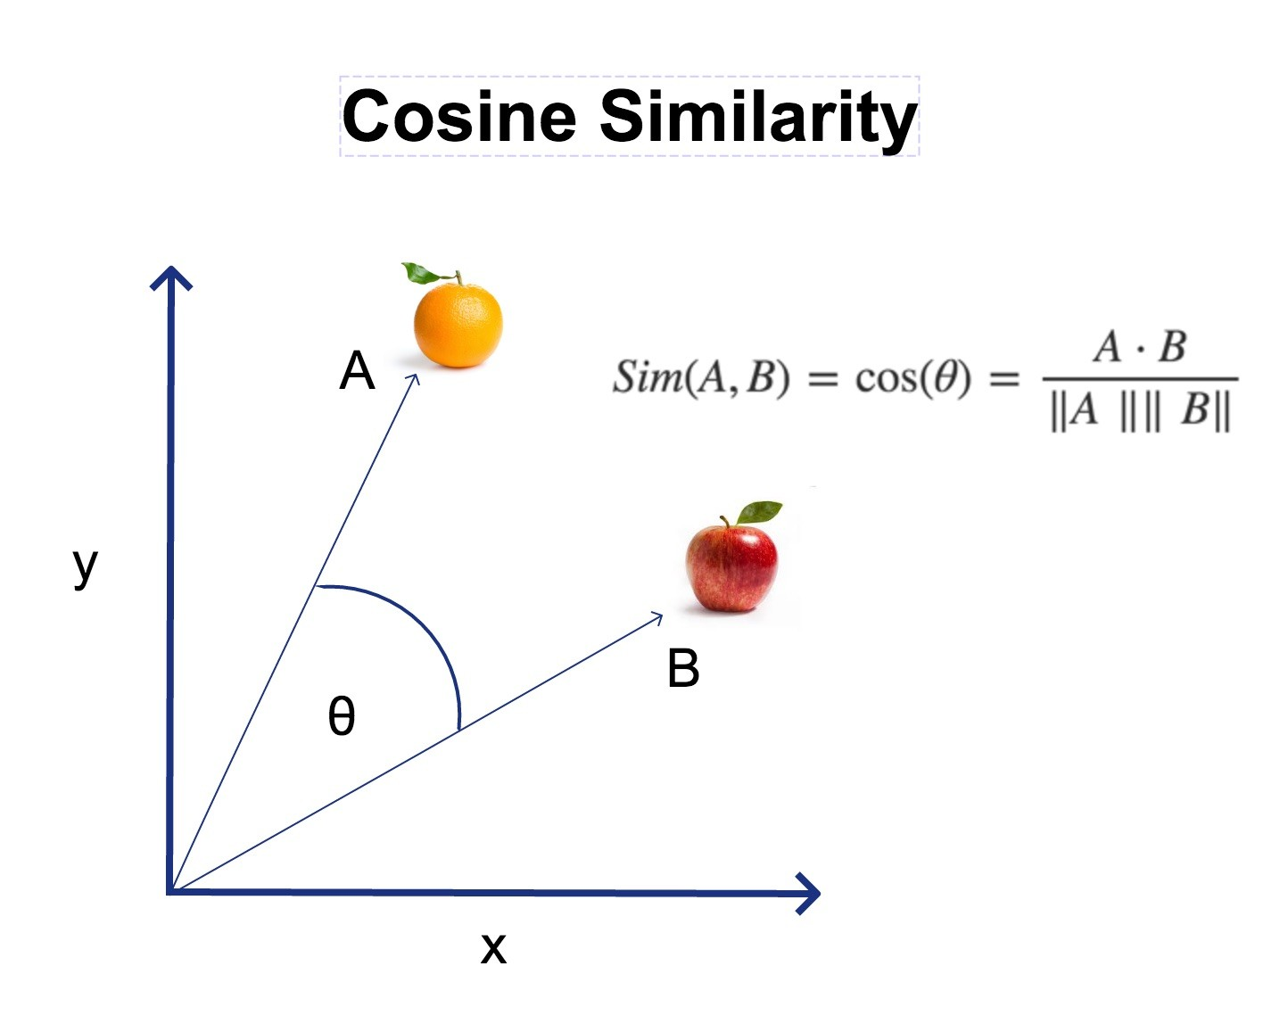
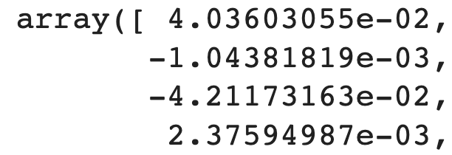
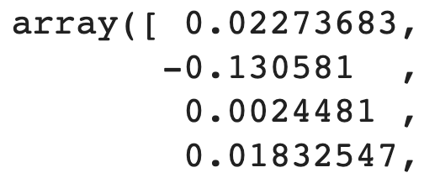

Data & EDA – Cosine similarity
Cosine similarity is a metric used to measure how similar two or more vectors are, other words similarity between 2 words
Cosine similarity is the cosine of the angle between 2 vectors
Process | Word1 | Word2
Word | Lizard | Reptile
Vectorized
Cosine Similarity | 0.7216
…
300 elements
…
300 elements

Slide 19
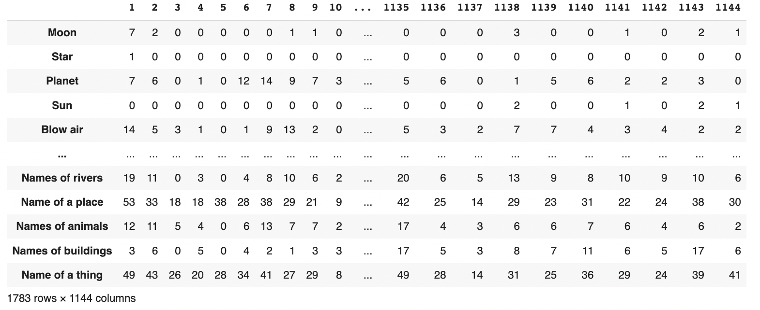
Data & EDA – Semantic domain distribution table
Shows number of captured words in each semantic domain by chapter
Columns
Number of Chapters
- Javanese(1,144), Malay(335)
Rows
1,783 of semantic domain words
Values
Number of corresponding words in each semantic domain

Slide 20
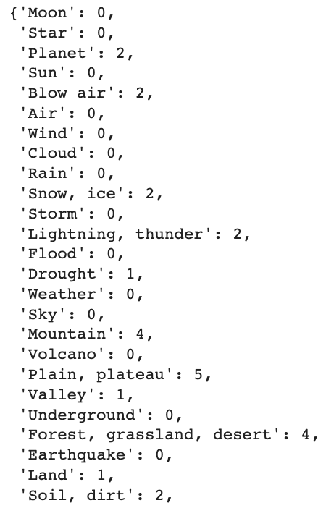
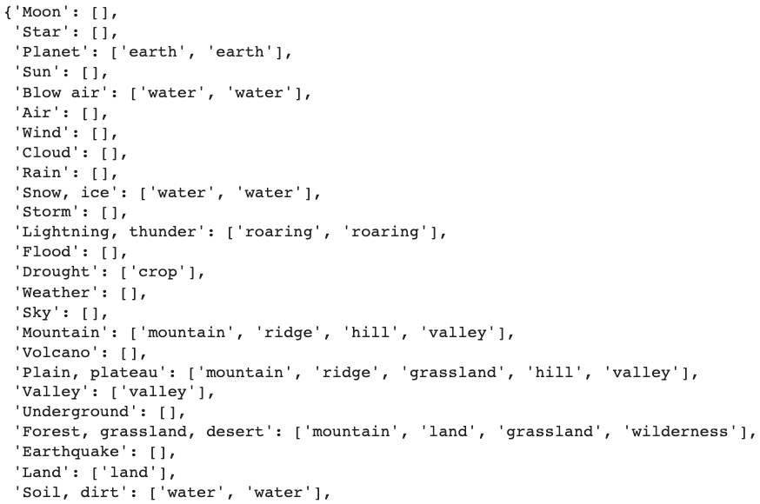
Data & EDA – EDA 1
Numbers and words in semantic domain order
Column-wise
Chapter: 500

Slide 21
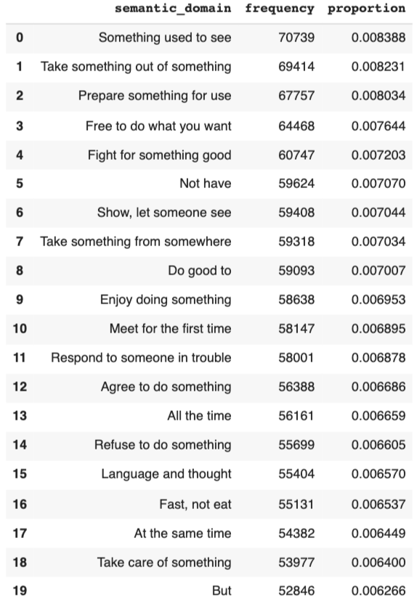
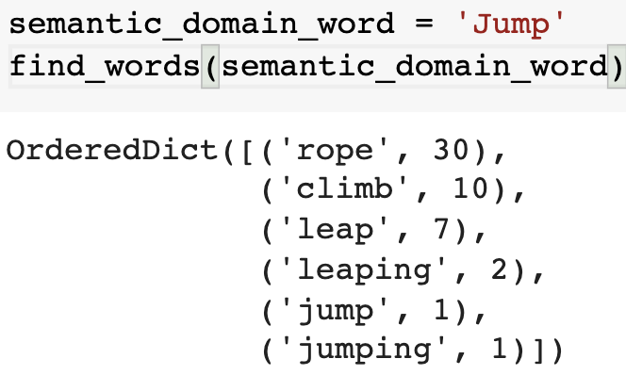
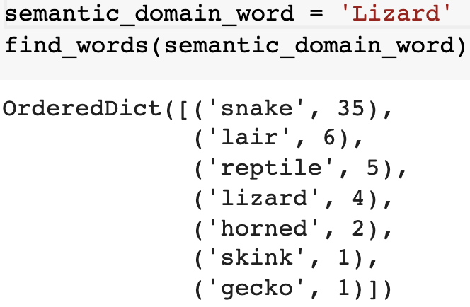
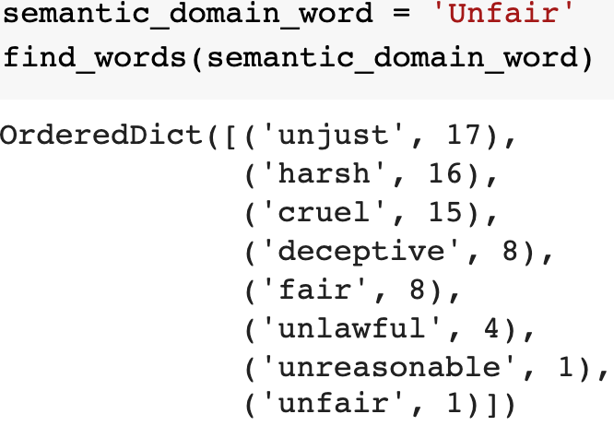
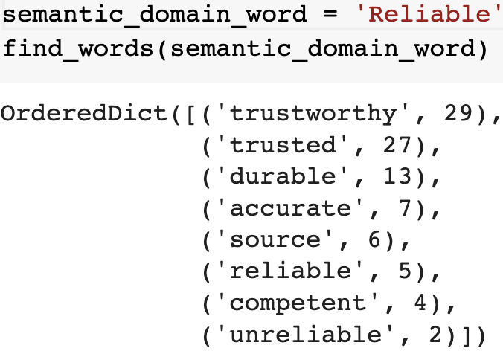
Data & EDA – EDA 2
Row-wise
Chapter: All

Slide 22
Data & EDA – Quantify chapters
Diversity
Depth
Proportion of captured semantic domain words, out of total number of semantic domains
Squared numbers to give more weights
Considers how many words are captured in each semantic domain, unlike diversity
Divide by the total sum of table (=110)
 | Ch1 | Ch2 | Sum
Moon | 9 | 0 | 9
Star | 64 | 0 | 64
Planet | 0 | 0 | 0
Sun | 1 | 36 | 37
Sum | 74 | 36 | 110
Depth | 74/110 | 36/110 | -
 | Ch1 | Ch2
Moon | 3 | 0
Star | 8 | 0
Planet | 0 | 0
Sun | 1 | 6
Diversity | 3/4 | 1/4

Slide 23
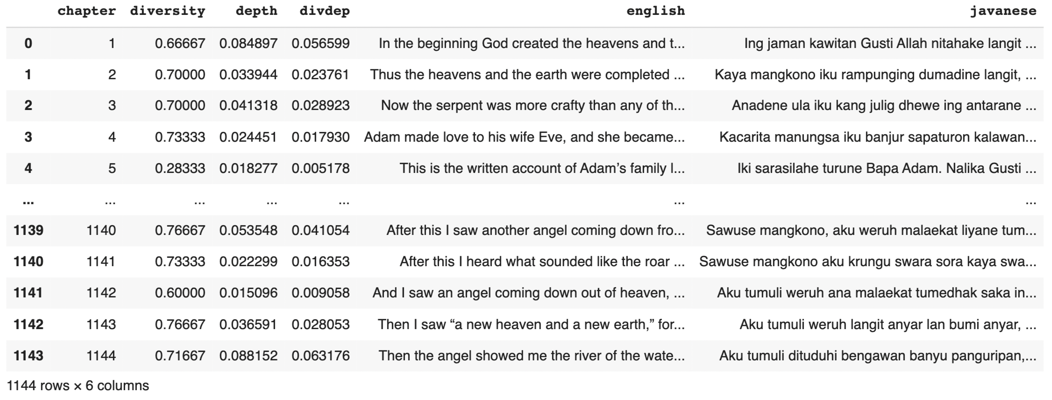
Data & EDA – 2 Parallel corpora with measures
Quantified properties of chapters in 3 different metrics
- Diversity, Depth, Diversity * Depth

Slide 24
Data & EDA – Input data
Data
Training (70%)
Sequential
Diversity
Diversity * Depth
Depth
Test (30%)
[Order of chapters of bible in different measurements]
Orders of Chapters | Sequential | Diversity order | Depth order | Divdep order
1 | 1 | 185 | 555 | 555
2 | 2 | 181 | 124 | 124
3 | 3 | 910 | 299 | 940
4 | 4 | 555 | 940 | 299
5 | 5 | 776 | 24 | 910
6 | 6 | 940 | 958 | 926
7 | 7 | 926 | 910 | 24

Slide 25
Model Building

Slide 26
Why JoeyNMT?
Open-Source
Customizable
NMT architecture
Sharable
Readability

Slide 27

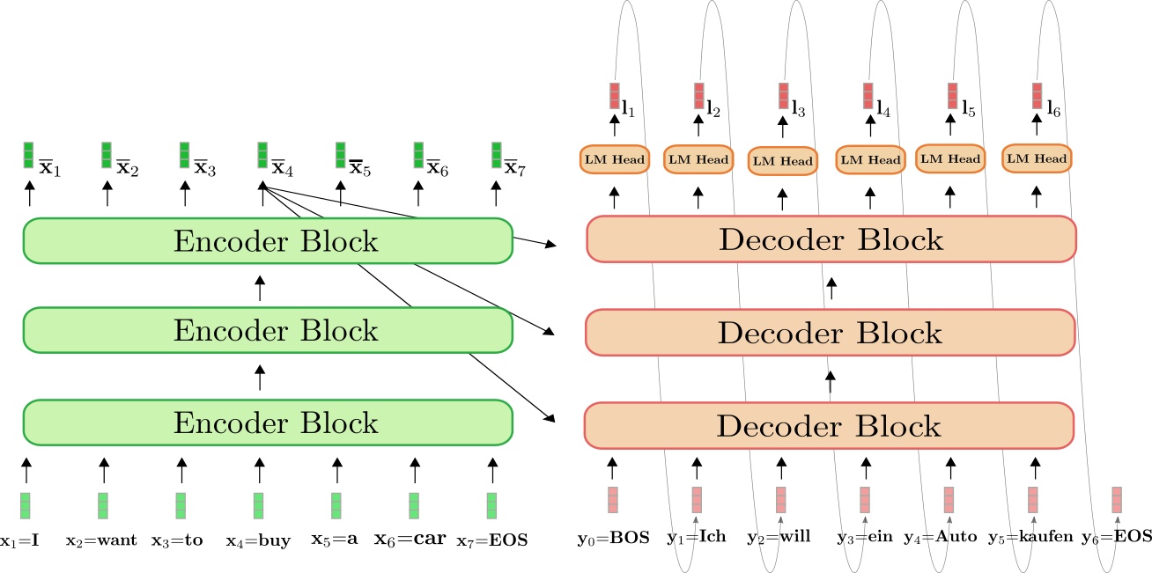
What is Neural Machine Translation
Notes:
The neural machine translation uses neural networks to translate source language sentences to target language sentences with two main sections: an encoder neural network and a decoder neural network. The ability of the model to encode the source text into an internal fixed-length representation termed the context vector is critical to the encoder-decoder architecture. However, this design has a drawback in that it cannot be used to train large text sequences. To resolve this issue, we converted the source and target sentences to a line- by-line alignment format.

Slide 28
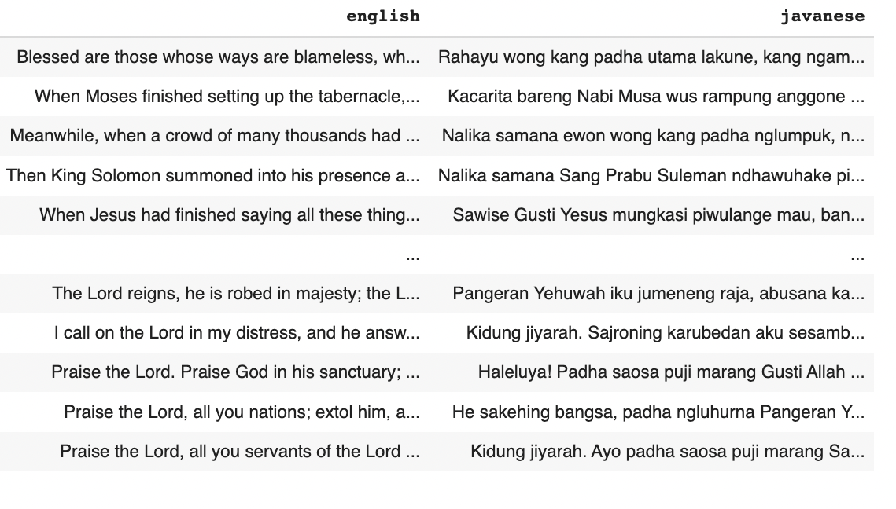
Model training using JoeyNMT
Verse-by-verse format

Slide 29
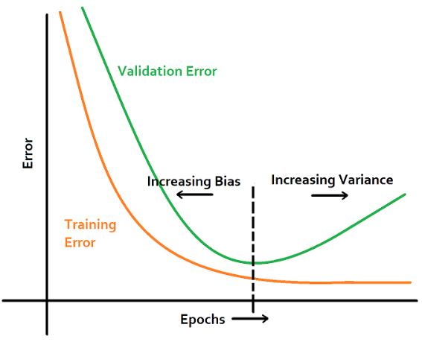
Model training using JoeyNMT
9 sizes of dataset:
4000, 4500, 6500, 7500, 9000, 10500, 13500, 17000, 20414 (rows)
150 Epochs
1 test dataset:
9000 (rows)
1000 rows as hold out validation
Early Stop
Shuffle
False
BLEU
As evaluation score

Slide 30
Business Benefits

Slide 31
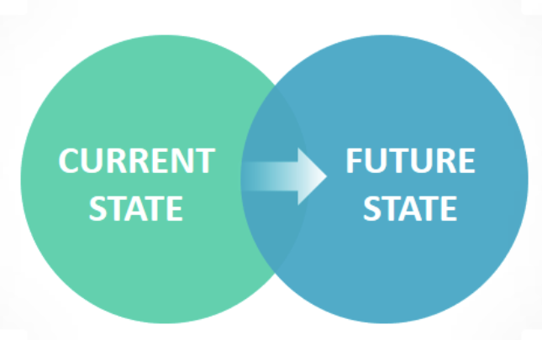
Business impact
SIL is currently engaged in 1600+ language projects around the world
SIL will expand the translation projects to up to 2000 by 2022
Our MT models in loop with human translators will lead to potential savings of $600k per project for SIL Or $6M for 10-15 large projects
Have direct costs to SIL of $1.3M per project
Reduce time to completion by 7-8 years.
Lasts up to 15 years
A set algorithm for translations engines, which will allow client to optimize the translation seed data

Slide 32
Results & Conclusion

Slide 33
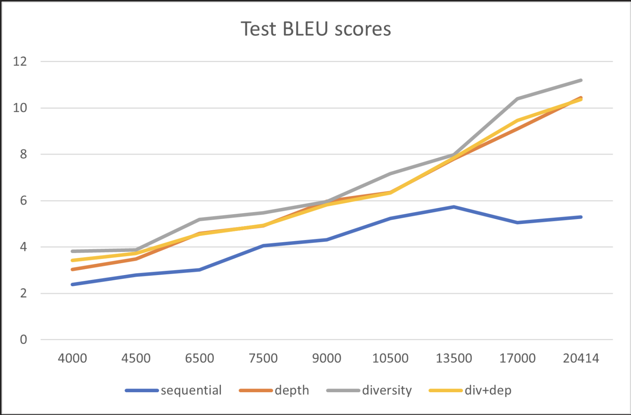

Statistical results
# of verses
BLEU score
Three different orders (Depth, Diversity, Depth+Diversity) outperformed sequential order significantly (using unpaired t-test)
Three models based on the suggested orders reached a similar BLEU score to that of sequential 20,414 verses, using only ~50% of that training data

Slide 34
Conclusion and recommendation
Statistical Result of our MT model (Javanese translation) shows that diversity of the semantic domain is the most significant parameter to achieve higher BLEU score for smaller as well as larger training data set.
We believe that adding the external supplemental data will boost the accuracy rate even more. However, that data should have sufficiently high or comparable diversity and depth score with Bible text.
A result for language and translation researchers, which will allow them to create models that run faster with lesser training data
A tool to save money and time, in translating low-level languages that have limited translation text available

Slide 35
Thank you
Any Questions?

Slide 36
Appendix

Slide 37
Problem Solving Approach
Approach - 1
Get a human to translate certain text or subdomain
Convert the text to TF-IDF vectorization to get a sense of semantic domains in a document. More the domains, more diverse a document is.
Using Similarity Scores such as the cosine similarity, gauge how different or similar the documents to be translated are from each other.
Once we have the similarity and diversity scores, use the original translated text to train different Neural Machine translation models on documents with all permutations and combinations of scores.
Compare the accuracy of those models to see what kind of documents give the highest accuracy.

Slide 38
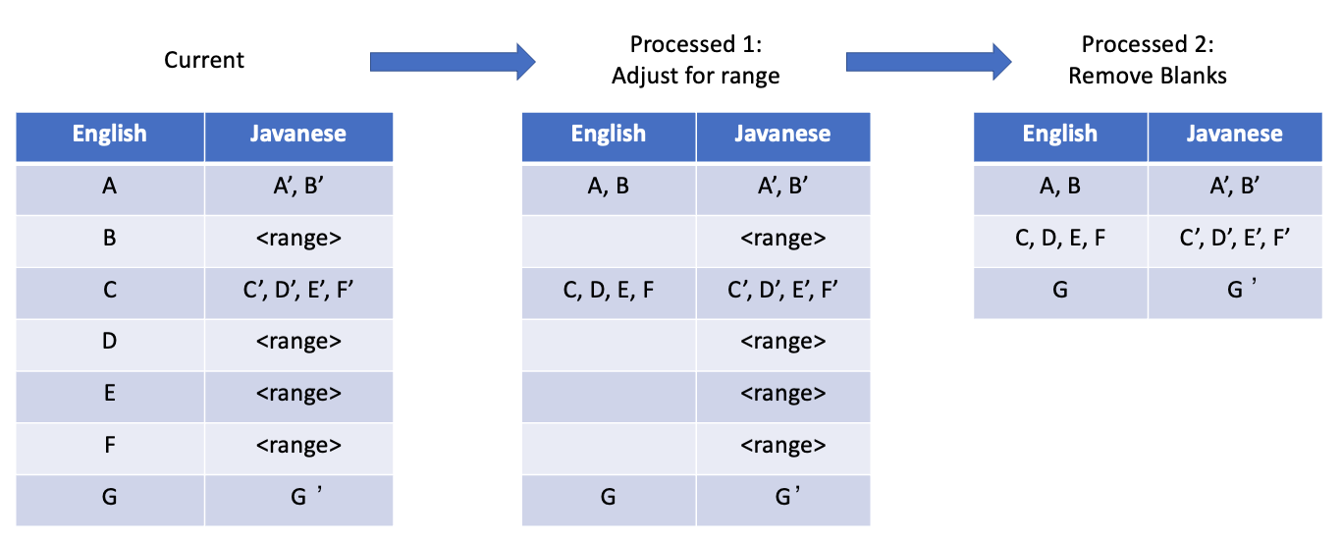
Data & EDA – Data Cleaning(P3)
Splitted into 2 parallel corpora dataframe (eng-jav, eng-mal)
Removed blanks and adjusted range issues

Slide 39
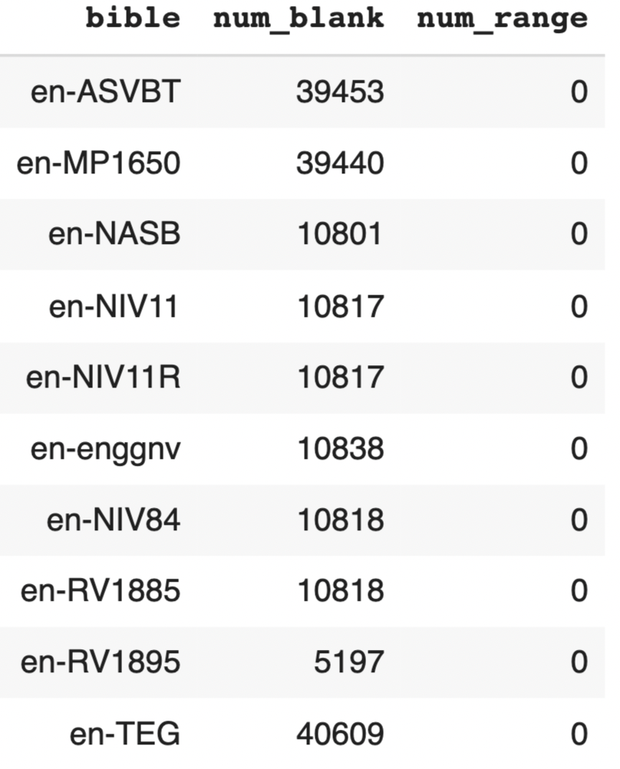
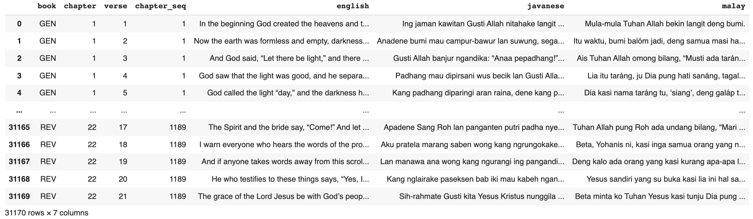
Data & EDA – Select bible(P1) and alignment(P2)
P1: NIV: close to original version, small number of blanks and no range
P2: Aligned 3 corpora
Process 1
Process 2

Slide 40
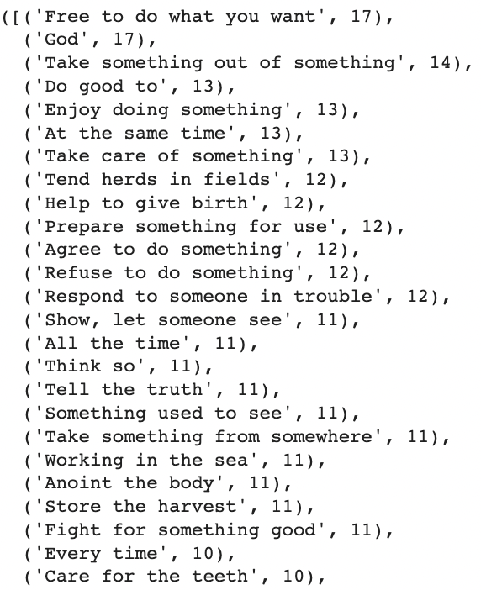
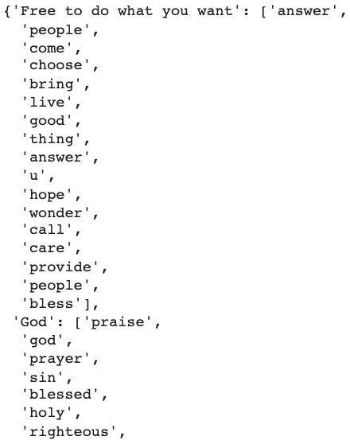
Data & EDA – More EDA
Numbers and words in descending order
Column-wise
Chapter: 500

Slide 41
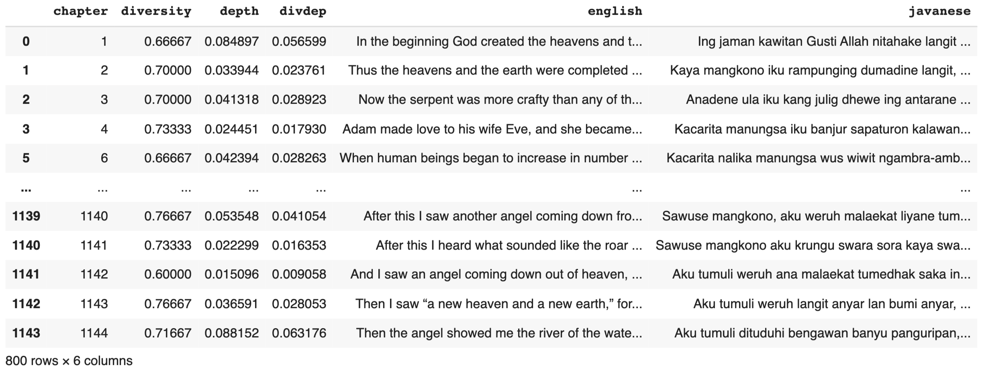
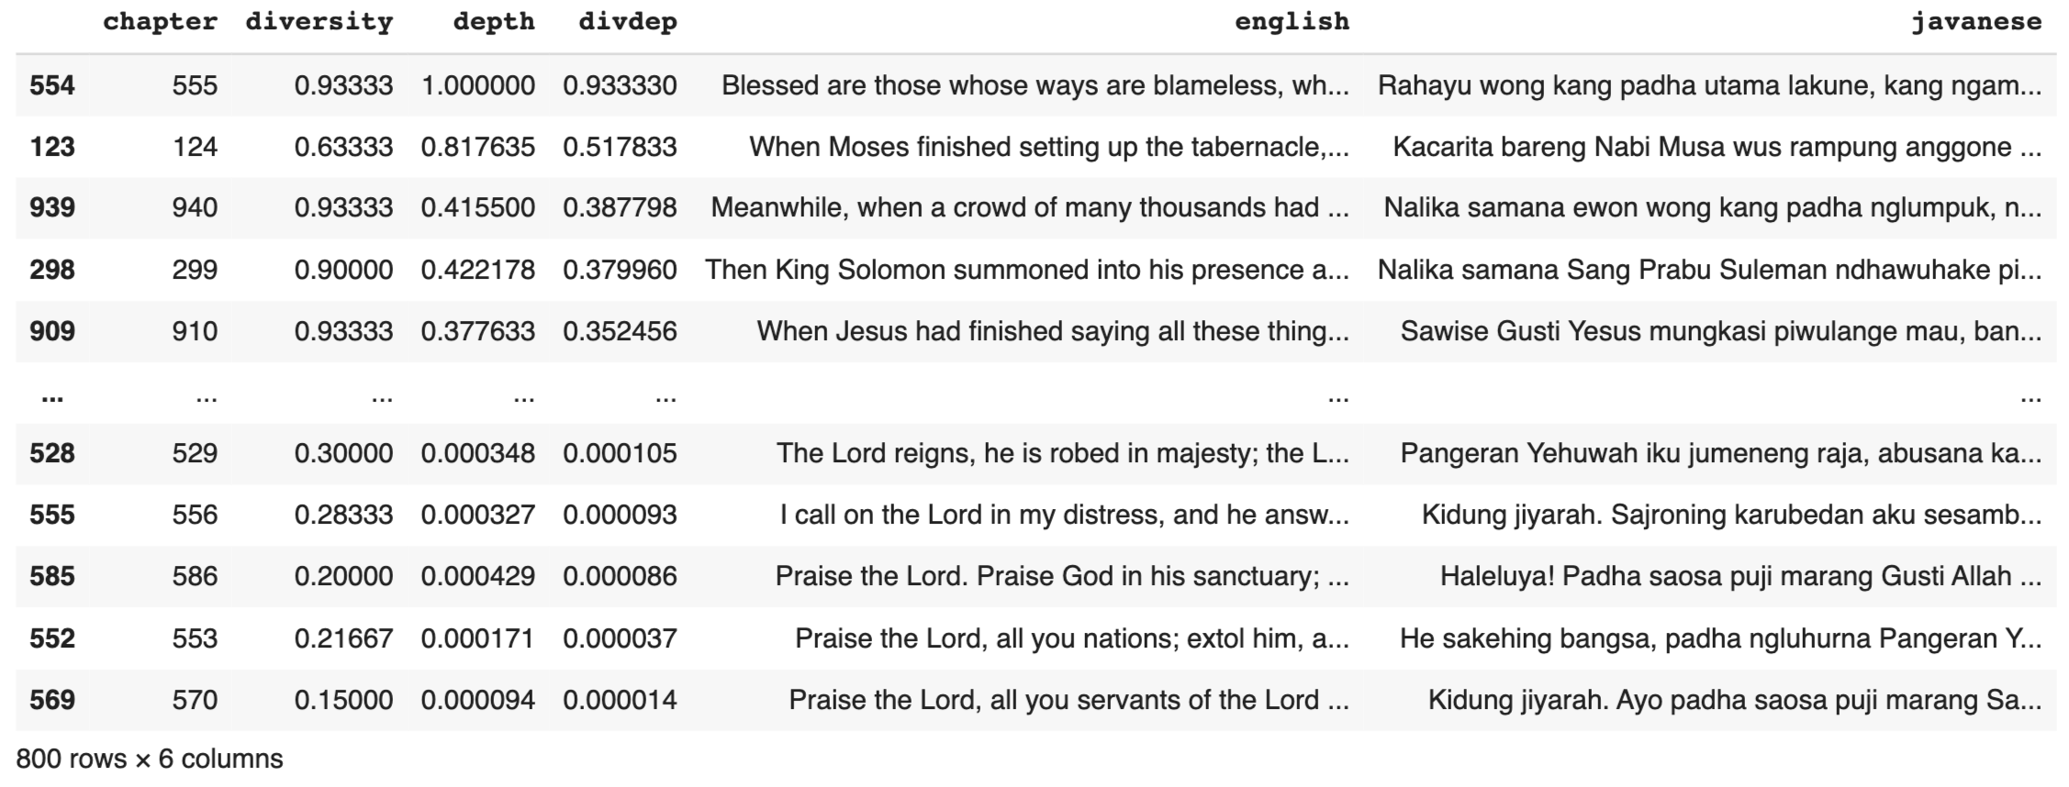
Data & EDA – Input data
Data
Training (70%)
Sequential
Diversity
Diversity * Depth
Depth
Test (30%)

Slide 42
Data & EDA – Input data
Data
Training (70%)
Sequential
Diversity
Diversity * Depth
Depth
Test (30%)

Slide 43
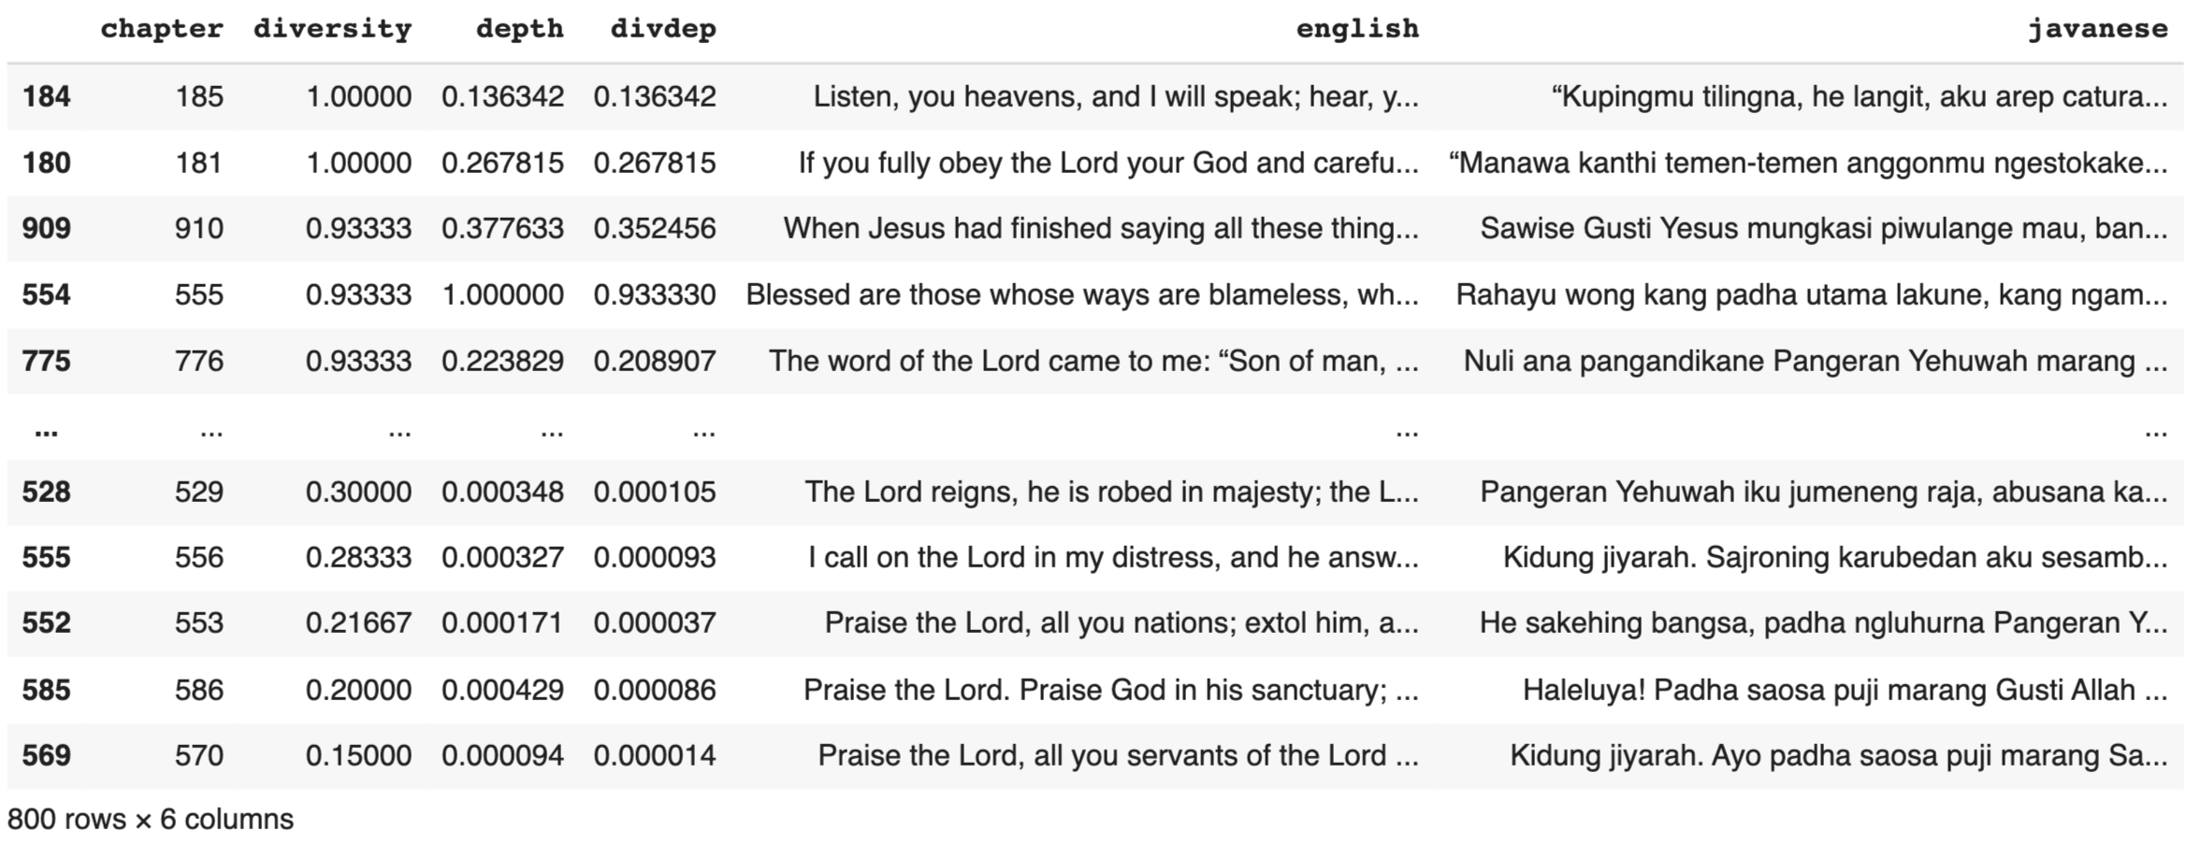
Data & EDA – Input data
Data
Training (70%)
Sequential
Diversity
Diversity * Depth
Depth
Test (30%)

Slide 44
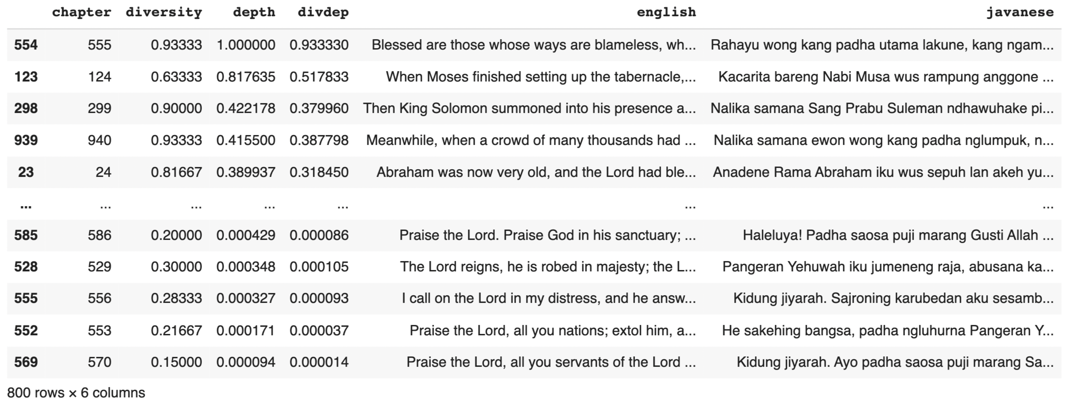
Data & EDA – Input data
Data
Training (70%)
Sequential
Diversity
Diversity * Depth
Depth
Test (30%)

Slide 45
Reference
OPUS: https://opus.nlpl.eu/
Bible data: https://www.faithcomesbyhearing.com/audio-bible-resources/bible-brain

